Slide 1
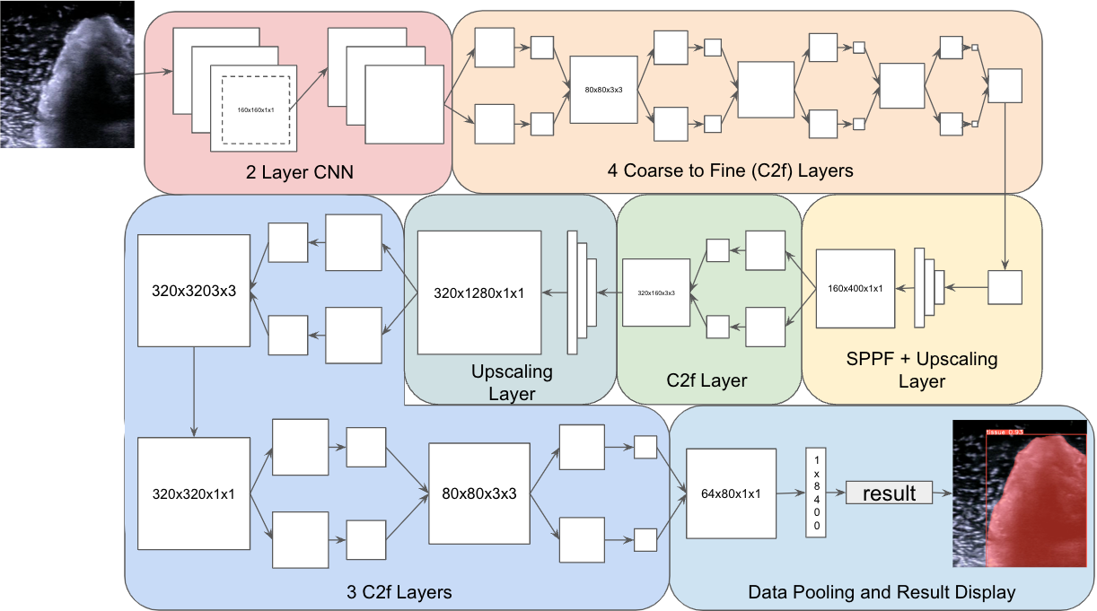
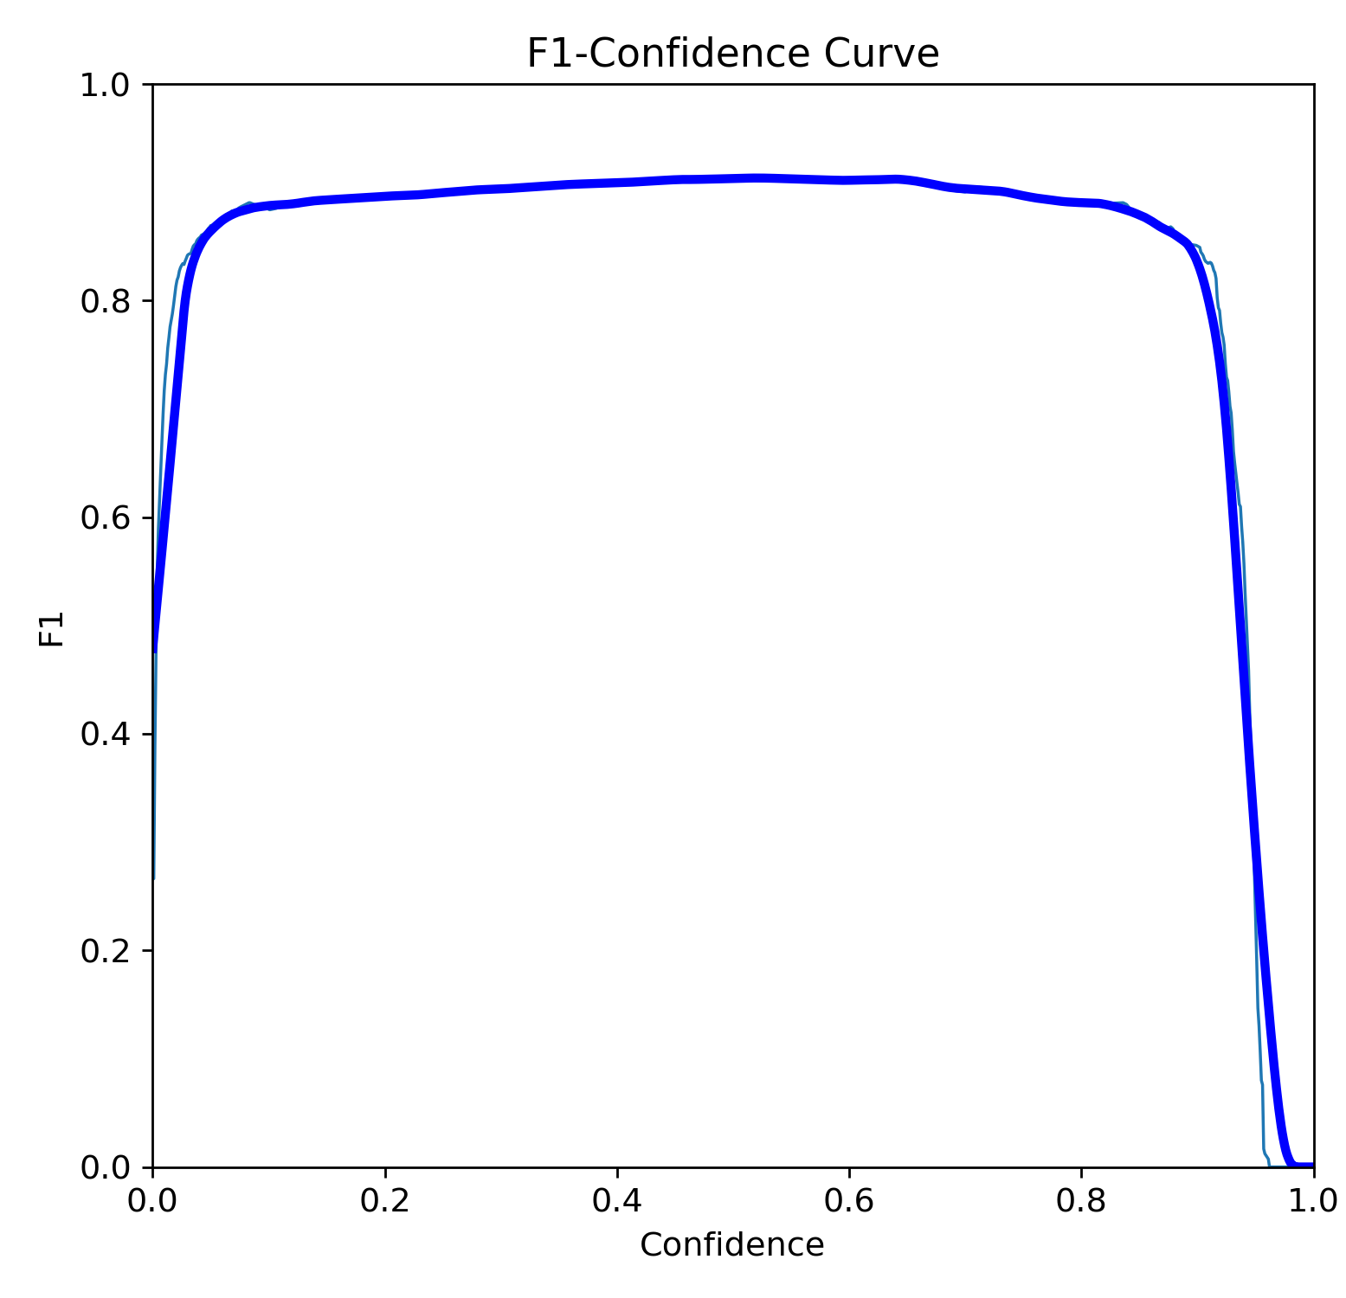
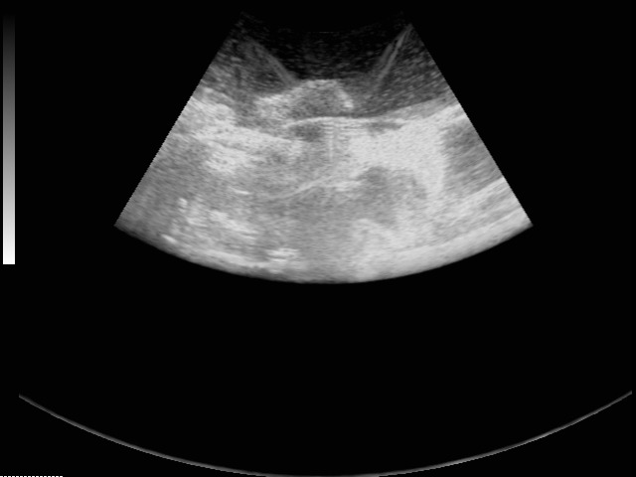
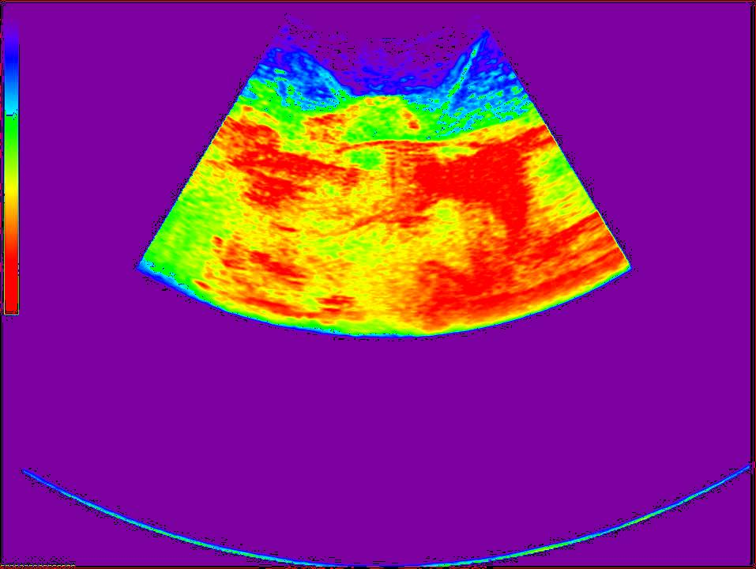
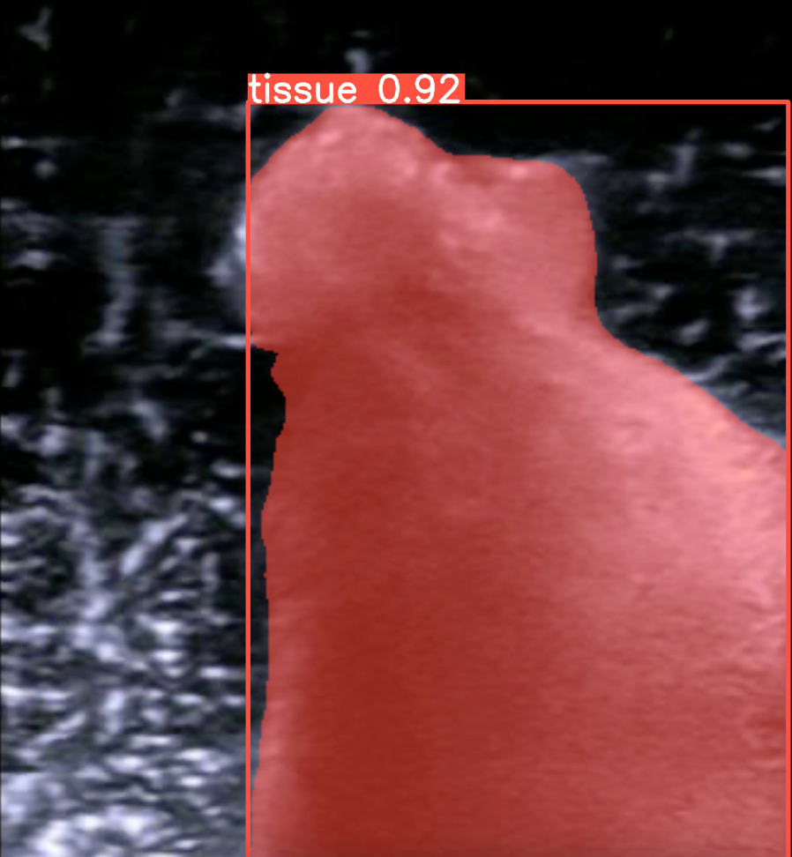
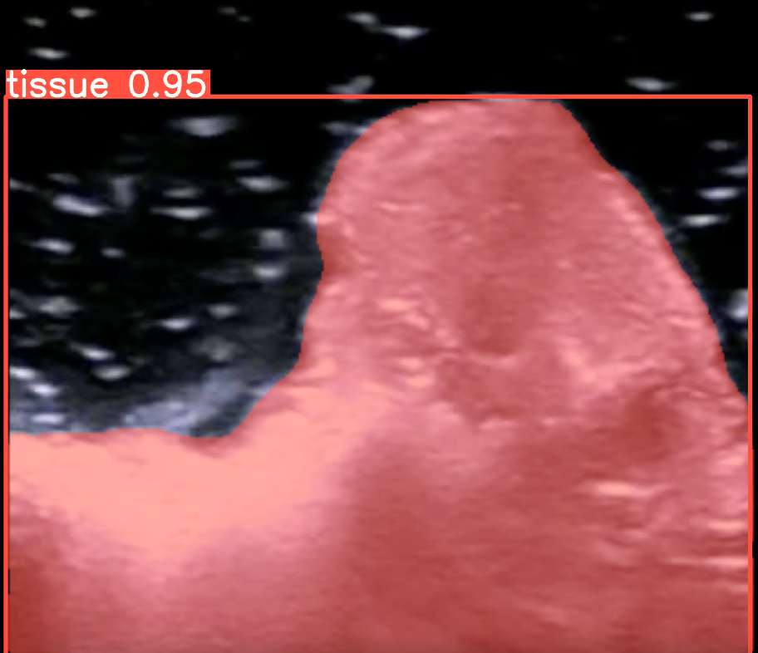
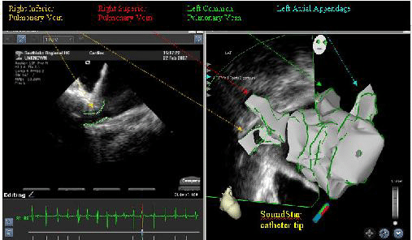

Tissue Detection in Ultrasound Images Using Real-Time Image Segmentation Model (HS-ENBM-0496)
Zain Shariff
INTRODUCTION
MATERIALS AND METHODS
RESULTS
DISCUSSION
Ultrasounds
sound waves with frequencies higher than the upper audible limit of human hearing (over 20KHz).
share physical properties of "normal" (audible) sound
The reflected waves have information of distance and signal of the object it bounced against (brightness).
Ultrasound in medical field
to identify organ structures in the body.
In my previous study, I found that:
Ultrasound can be used to identify changes in tissue exposed to microwave energy (though statistically significant were not clearly appreciated on unassisted eyes).
Translating the images to polychromatic representation resulted in visual appreciation of the changes
Present study is to define the tissue borders using algorithms which would further assist having automated mechanisms to identify structures and changes.
YOLOv8 by Ultralytics
Real time image segmentation model
Uses deep learning and computer vision
Displays mask and contours
outline an object in an image
Computer Vision can help with identifying contours of tissues in ultrasound scans
The goal of my engineering project is to develop an image segmentation model for identification of tissue in ultrasound images.
Materials:
Chicken Muscle Tissue
Lamb Muscle Tissue
3.5 MHz 2D Ultrasound
Sharp Knife
Small container
Water
Supported Computer for pip, python, and Ultralytics as well as dependencies
Image Collection:
Tissue is cut to a 2 cm in thickness (as measured in raw status).
Record Two 4-Second Ultrasound Scans for each tissue
Use Python Program to splice videos into frames
Import onto Roboflow
Annotate and export
Model Training:
Use CLI command to train the YOLOv8 extra large segmentation model, the dataset from Roboflow, image size of 640, 500 epochs, and 50 patience
The output is a trained model, curves and data are saved on a .csv file for interpretation
1829 images are gathered, and reduced to 1595 images for annotations
1117 images are used base training, 319 images are used for validation, 159 images are used for test
Training ran for 111 epochs, in which overfitting was observed
The best model was obtained at the 86 epoch
mAP50-95(M) was 0.85115
F1 Score was measure at 0.91 at 0.521 confidence
Image Inferences are done reliably less than 300 ms
These scores indicate that the model is competent to do image segmentation reliably
Presently endocardial borders of the heart are manually annotated to help with management of heart failure and for atrial fibrillation ablation procedures
Segmentation Model for visualization of Left Ventricle
Defining manually the borders of tumors on ultrasound images to define size and volume
Future applications
Real time machine based defining borders can be used in clinical practice to make procedure more time efficient
Model can be used for three-dimensional recreation of organ structure
Can be used to assist with ablations performed for malignancies and cardiac procedures
The final model can trace contours of tissue on ultrasound scans reliably and can be integrated into real-time purposes.
REFERENCES (APA)
Carneiro, G. (2012). The Segmentation of the Left Ventricle of the Heart From Ultrasound Data Using Deep Learning Architectures and Derivative-Based Search Methods. IEEE Transactions on Image Processing, 21(3):968–982.
Enriquez, A. (2018). Use of Intracardiac Echocardiography in Interventional Cardiology. Circulation, 137(21):2278–2294.
Hwang, Y. N. (2015). Classification of focal liver lesions on ultrasound images by extracting hybrid textural features and using an artificial neural network. Bio-Medical Materials and Engineering, 26(s1):S1599–S1611.
Jocher, G. (2023). Ultralytics YOLO. original-date: 2022-09-11T16:39:45Z.
McMahon, M. (2024). What is Cardiac Ultrasound? (with pictures).
CRITERIA AND CONSTRAINTS
Criteria:
Identify tissue in ultrasound scans
Trace contours of the tissue
An accurate model is defined as:
Have a mAP50-95 rating of above 0.8
F1 Score must be 0.5+-0.05
Constraints:
Be able to integrate in real time purposes
QR Code for GitHub Repository

